Slide 1
Usability Toolkit

Slide 2
Usability Toolkit
for health information systems
Integrated guidance and tools
for use by VA project teams
to adopt human-centered practices
that lead to usable systems.

Slide 3
Team
Ross Speir
Program Manager, Usability Engineer
OHI Human Factors Engineering
Scott Wood, PhD
Health System Specialist, Human-Computer Interaction and Clinical Decision Support
OHI Knowledge Based Systems
Kas Adams
Informatics Evaluation Manager
Northwest Innovation Center
Stephanie Tallett
Human Factors Analyst
Northwest Innovation Center
Crystal Rojas
Quality Consultant, Informatics Nurse Specialist
VA Long Beach Healthcare System
Julian Brunner, PhD
Health Services Researcher
HSR&D Center of Innovation

Slide 4
Usability - The extent to which a system, product or service can be used by specified users to achieve specified goals with effectiveness, efficiency and satisfaction in a specified context of use.
ISO 9241-11 (2018)

Slide 5
Target Health Information System
Clinical Reminder Dialog Template
Issues with template development
Lack of standardization in the design process
Lack of awareness and utilization of design techniques
Lack of usability test rigor (design and implementation)
Impact on resulting templates
May negatively impacting clinician effectiveness and efficiency
May lack, or use inconsistently, structured data
May require delays getting templates into the field, or post-deployment rework

Slide 6
Assess viability
Engaged with end users, SMEs, and project teams
Clinical Application Coordinators (CAC)
Usability Specialists
User Interface Designers
Health Services Researchers
Lead for KBS CDS training
National Emergency Medicine Reminder Dialog project team
Looked for quick wins
Pain points for project teams
Existing resources
High-impact materials

Slide 7
Problems to address
Poor template usability
Increases unnecessary HIT burden on end users
Decreases care delivery efficiency
Decreases care delivery effectiveness
Decreases end user satisfaction
Increases field informatics workload regarding support and maintenance
Lack of usability resources for clinical reminder templates
Increases variability in CRDT quality
Increases development time
Increases maintenance costs from poor usability incidents
Decreases traceability of design decisions

Slide 8
Approach
Create a standardized process
Best practices for human-centered design
From design through deployment
Structured but versatile
Develop guidance and tools
Proven effective in HIS projects
Tailored for VA project teams
Can be utilized outside of the recommended process
Pilot and iterate
Engage with VA project teams
Publish materials, assess value, improve

Slide 9
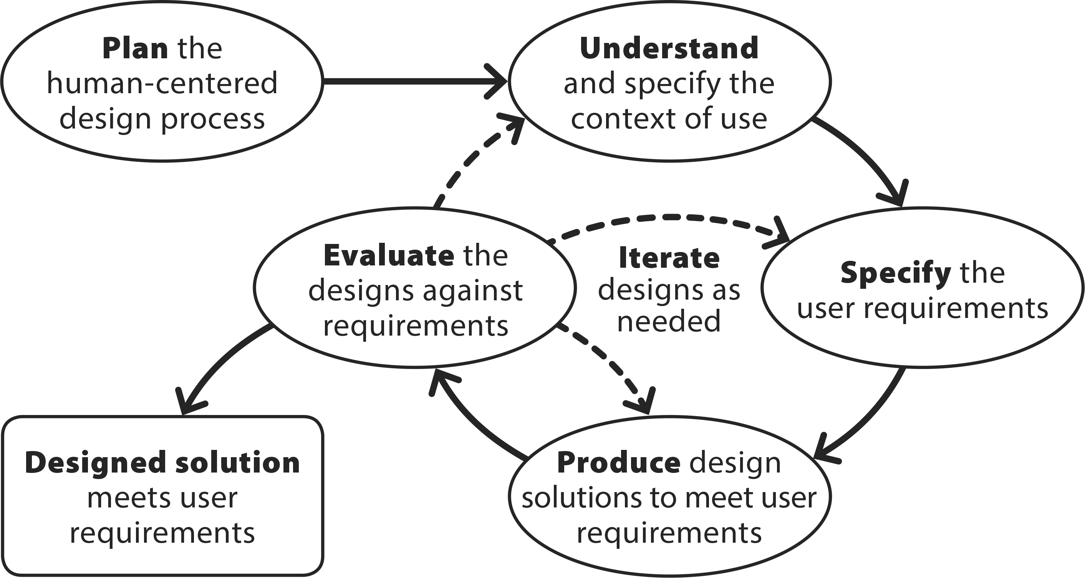
Human-centered Design
Human-centered design for interactive systems (ISO 9241-210)
Adapted from ISO 9241-210

Slide 10
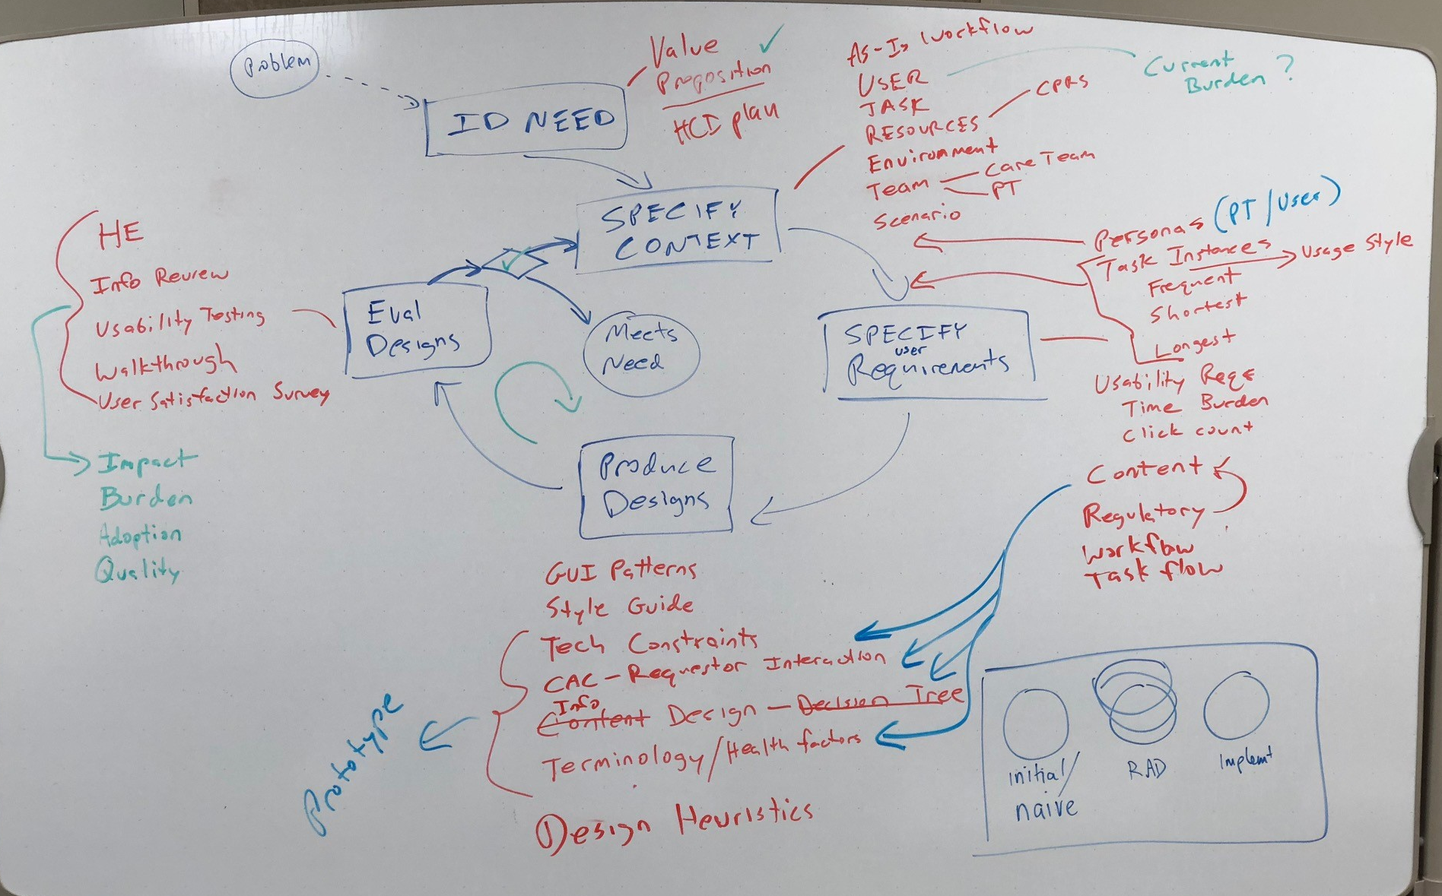
Vision

Slide 11



Guidance and Tools
Plan the human-centered design process
Value Proposition for a HIS project
Applying HCD to your project
SharePoint site template for HIS design work
VHA case studies
Plan the human-centered design process

Slide 12
Guidance and Tools
Understand and specify the context of use
Identifying socio-technical impacts on usability
Observing clinical work
Mapping clinical workflow
Mapping clinical information flow
Understand and specify the context of use

Slide 13
Guidance and Tools
Specify the user requirements
Creating Scenarios of Use
Specifying HIS Design Objectives
Benchmarking user performance
Specify the user requirements

Slide 14
Guidance and Tools
Produce design solutions to meet user requirements
User interface standards for Reminder Dialogs
Rapid prototyping guidance
Design patterns for Reminder Dialogs
Produce design solutions to meet user requirements

Slide 15
Guidance and Tools
Evaluate the designs against requirements
Usability heuristics for EHRs
Heuristic Evaluation Tool
Usability heuristics for CDS
Usability Walkthrough Tool
In Situ usability assessment Tool
Evaluate the designs against requirements

Slide 16
Guidance and Tools
Design solutions meet user requirements
Usability Workbook
Designed solution meets user requirements

Slide 17
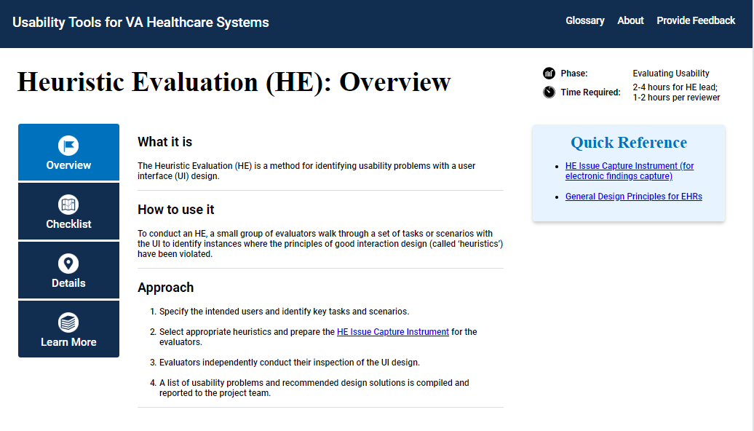
Heuristic evaluation tool

Slide 18
Questions?
Discussion.

